Slide 1
CSE 311: Foundations of Computing
Lecture 9: English Proofs, Strategies & Number Theory

Slide 2
Last class: Inference Rules for Quantifiers
P(c) for some c
∴ ∃x P(x)
∀x P(x)
∴ P(a) (for any a)
Intro ∃
Elim ∀
∃x P(x)
∴ P(c) for some special** c
“Let a be arbitrary*”...P(a)
∴ ∀x P(x)
Elim ∃
Intro ∀
** c is a NEW name.
List all dependencies for c.
* in the domain of P. No other name in P depends on a.
dependencies:
other named arbitrary constants in ∃x P(x)
Notes:
We can write “Let a be an object” and then apply Elim For All

Slide 3
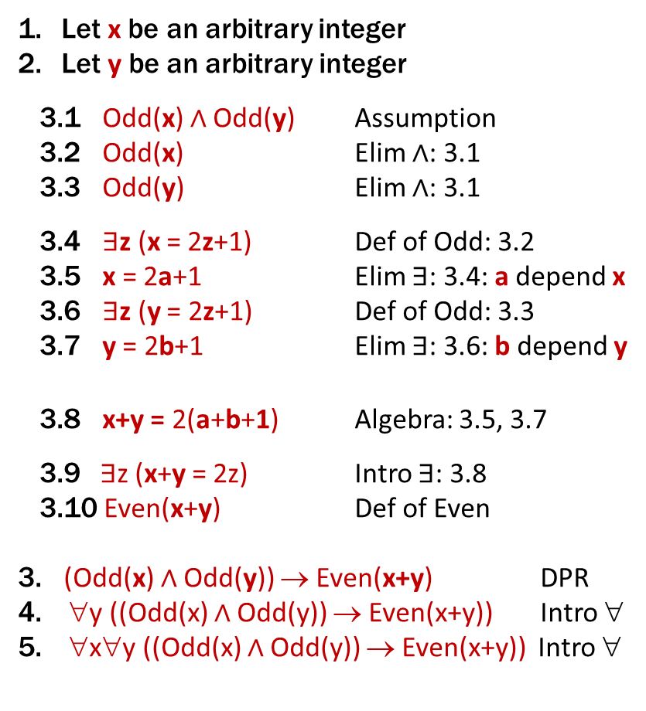
Last class: Formal & English Proofs: Even and Odd
Even(x) ≡ ∃y (x=2y)
Odd(x) ≡ ∃y (x=2y+1)
Domain: Integers
Prove “The sum of two odd numbers is even.”
Let x and y be arbitrary integers.
Suppose that both are odd.
Then, we have x = 2a+1 for some integer a and y = 2b+1 for some integer b.
Their sum is x+y = ... = 2(a+b+1)
so x+y is, by definition, even.
Since x and y were arbitrary, the sum of two odd integers is even.
Let x be an arbitrary integer
Let y be an arbitrary integer
3.1 Odd(x) ∧ Odd(y) Assumption
3.2 Odd(x) Elim ∧: 3.1
3.3 Odd(y) Elim ∧: 3.1
3.4 $∃$z (x = 2z+1) Def of Odd: 3.2
3.5 x = 2a+1 Elim ∃: 3.4: a depend x
3.6 $∃$z (y = 2z+1) Def of Odd: 3.3
3.7 y = 2b+1 Elim ∃: 3.6: b depend y
3.8 x+y = 2(a+b+1) Algebra: 3.5, 3.7
3.9$∃$z (x+y = 2z) Intro ∃: 3.8
3.10 Even(x+y) Def of Even
3. (Odd(x) ∧ Odd(y)) → Even(x+y) DPR
∀y ((Odd(x) ∧ Odd(y)) → Even(x+y)) Intro ∀
∀x∀y ((Odd(x) ∧ Odd(y)) → Even(x+y)) Intro ∀
Notes:
We skip lines stating “there exists” and just immediately name that object.
We skip lines stating implication proven by direct proof rule.

Slide 4

Last class: Even and Odd
Predicate Definitions
Even(x) ≡ $∃y \left(x=2y\right)$
Odd(x) ≡ $∃y (x=2y+1)$
Domain of Discourse
Integers
Prove “The sum of two odd numbers is even.”
Proof: Let x and y be arbitrary integers.
Suppose that both are odd. Then, we have x = 2a+1 for some integer a and y = 2b+1 for some integer b. Their sum is x+y = (2a+1) + (2b+1) = 2a+2b+2 = 2(a+b+1), so x+y is, by definition, even.
Since x and y were arbitrary, the sum of any two odd integers is even.
∀x ∀y ((Odd(x) ∧ Odd(y))→Even(x+y))

Slide 5
Rational Numbers
Domain of Discourse
Real Numbers
A real number x is rational iff there exist integers a and b with b≠0 such that x=a/b.
Rational(x) := ∃a ∃b (((Integer(a) ∧ Integer(b)) ∧ (x=a/b)) ∧ b≠0)

Slide 6
Rationality
Domain of Discourse
Real Numbers
Predicate Definitions
Rational(x) := $∃a ∃b (Integer\left(a\right)∧Integer\left(b\right)∧\left(x=a/b\right)∧\left(b≠0\right))$
Prove: “The product of two rationals is rational.”
Formally, prove ∀x ∀y ((Rational(x) ∧ Rational(y)) → Rational(xy))
Notes:
Note: this is just an implication, with x and y as constants.

Slide 7
Rationality
Domain of Discourse
Real Numbers
Predicate Definitions
Rational(x) := $∃a ∃b (Integer\left(a\right)∧Integer\left(b\right)∧\left(x=a/b\right)∧\left(b≠0\right))$
Prove: “The product of two rationals is rational.”
Proof: Let x and y be arbitrary reals.
Suppose x and y are rational.
Thus, xy is rational.
Since x and y were arbitrary, we have shown that the product of any two rationals is rational.
∀x ∀y ((Rational(x) ∧ Rational(y)) → Rational(xy))
Notes:
English proofs will often skip the first and last parts since they are boilerplate.

Slide 8
Rationality
Domain of Discourse
Real Numbers
Predicate Definitions
Rational(x) := $∃a ∃b (Integer\left(a\right)∧Integer\left(b\right)∧\left(x=a/b\right)∧\left(b≠0\right))$
Prove: “The product of two rationals is rational.”
Proof: Let x and y be arbitrary rationals.
Then, x = a/b for some integers a, b, where b≠0, and y = c/d for some integers c, d, where d≠0.
Multiplying, we get that xy = (a/b)(c/d) = (ac)/(bd).
Now ac and bd are integers. Also, since b ≠0 and d≠0 Thus, xy is rational.
Since x and y were arbitrary, we have shown that the product of any two rationals is rational.
∀x ∀y ((Rational(x) ∧ Rational(y)) → Rational(xy))
Notes:
English proofs will often skip the first and last parts since they are boilerplate.

Slide 9
Rationality
Domain of Discourse
Real Numbers
Predicate Definitions
Rational(x) := $∃a ∃b (Integer\left(a\right)∧Integer\left(b\right)∧\left(x=a/b\right)∧\left(b≠0\right))$
Prove: “The product of two rationals is rational.”
Proof: Let x and y be arbitrary rationals.
Then, x = a/b for some integers a, b, where b≠0, and y = c/d for some integers c, d, where d≠0.
Multiplying, we get that xy = (a/b)(c/d) = (ac)/(bd).
Now ac and bd are integers. Also, since b ≠0 and d≠0 Thus, xy is rational.
Since x and y were arbitrary, we have shown that the product of any two rationals is rational.
∀x ∀y ((Rational(x) ∧ Rational(y)) → Rational(xy))
Notes:
English proofs will often skip the first and last parts since they are boilerplate.

Slide 10
Rationality
Domain of Discourse
Real Numbers
Predicate Definitions
Rational(x) := $∃a ∃b (Integer\left(a\right)∧Integer\left(b\right)∧\left(x=a/b\right)∧\left(b≠0\right))$
Prove: “The product of two rationals is rational.”
Proof: Let x and y be arbitrary rationals.
Then, x = a/b for some integers a, b, where b≠0, and y = c/d for some integers c, d, where d≠0.
Multiplying, we get that xy = (a/b)(c/d) = (ac)/(bd).
Now ac and bd are integers. Also, since b ≠0 and d≠0 By definition, then, xy is rational.
Since x and y were arbitrary, we have shown that the product of any two rationals is rational.
∀x ∀y ((Rational(x) ∧ Rational(y)) → Rational(xy))
Notes:
English proofs will often skip the first and last parts since they are boilerplate.

Slide 11
Rationality
Domain of Discourse
Real Numbers
Predicate Definitions
Rational(x) := $∃a ∃b (Integer\left(a\right)∧Integer\left(b\right)∧\left(x=a/b\right)∧\left(b≠0\right))$
Prove: “The product of two rationals is rational.”
Proof: Let x and y be arbitrary rationals.
Then, x = a/b for some integers a, b, where b≠0, and y = c/d for some integers c, d, where d≠0.
Multiplying, we get that xy = (a/b)(c/d) = (ac)/(bd).
Now ac and bd are integers. Also, since b ≠0 and d≠0 By definition, then, xy is rational.
Since x and y were arbitrary, we have shown that the product of any two rationals is rational.
∀x ∀y ((Rational(x) ∧ Rational(y)) → Rational(xy))
Notes:
English proofs will often skip the first and last parts since they are boilerplate.

Slide 12
Rationality
Domain of Discourse
Real Numbers
Predicate Definitions
Rational(x) := $∃a ∃b (Integer\left(a\right)∧Integer\left(b\right)∧\left(x=a/b\right)∧\left(b≠0\right))$
Prove: “The product of two rationals is rational.”
Proof: Let x and y be arbitrary rationals.
Then, x = a/b for some integers a, b, where b≠0, and y = c/d for some integers c, d, where d≠0.
Multiplying, we get that xy = (a/b)(c/d) = (ac)/(bd).
ac and bd are integers. Also, since b ≠0 and d≠0 we have bd≠0. By definition, then, xy is rational.
Since x and y were arbitrary, we have shown that the product of any two rationals is rational.
∀x ∀y ((Rational(x) ∧ Rational(y)) → Rational(xy))
Notes:
English proofs will often skip the first and last parts since they are boilerplate.

Slide 13
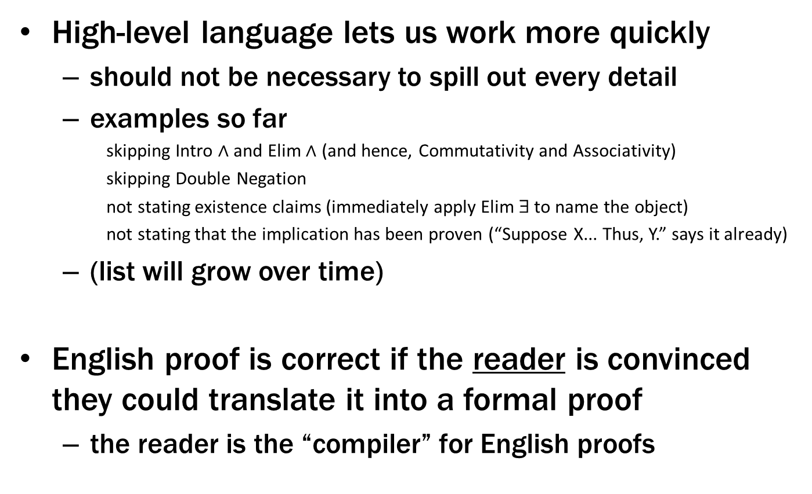
English Proofs
High-level language lets us work more quickly
should not be necessary to spill out every detail
examples so far
skipping Intro $∧$ and Elim $∧$ (and hence, Commutativity and Associativity)
skipping Double Negation
not stating existence claims (immediately apply Elim ∃ to name the object)
not stating that the implication has been proven (“Suppose X... Thus, Y.” says it already)
(list will grow over time)
English proof is correct if the reader is convinced they could translate it into a formal proof
the reader is the “compiler” for English proofs

Slide 14
Proof Strategies

Slide 15
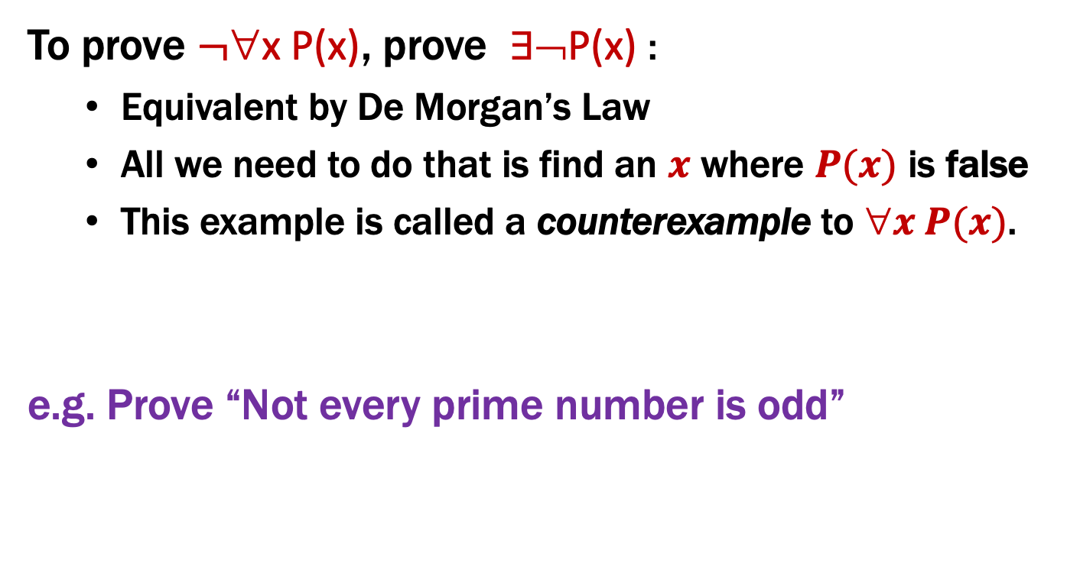
Proof Strategies: Counterexamples
To prove $¬$∀x P(x), prove ∃¬P(x) :
Equivalent by De Morgan’s Law
All we need to do that is find an $x$ where $P(x)$ is false
This example is called a counterexample to $x P(x)$.
e.g. Prove “Not every prime number is odd”
Proof: 2 is a prime that is not odd — a counterexample to the claim that every prime number is odd.
An English proof does not need to cite De Morgan’s law.

Slide 16
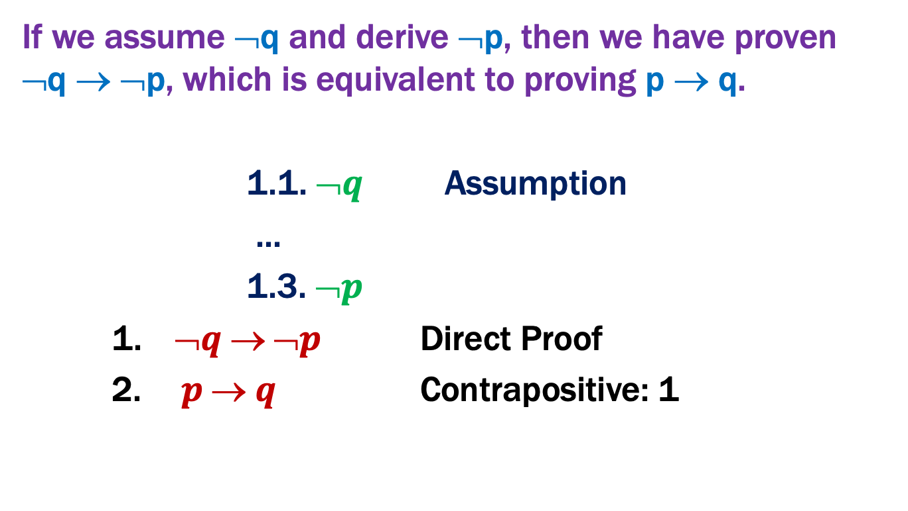
Proof Strategies: Proof by Contrapositive
If we assume ¬q and derive ¬p, then we have proven ¬q → ¬p, which is equivalent to proving p → q.
1.1. $➢q$ Assumption
...
1.3. $➢p$
1. $➢q  ➢p$ Direct Proof
2.$p  q$ Contrapositive: 1
Notes:
English proof would start “We will prove the contrapositive. Suppose not q ... Thus, not p.”

Slide 17


Proof Strategies: Proof by Contrapositive
If we assume ¬q and derive ¬p, then we have proven ¬q → ¬p, which is equivalent to proving p → q.
We will prove the contrapositive.
Suppose $➢q$.
...
Thus, $➢p$.
1.1. $➢q$ Assumption
...
1.3. $➢p$
1. $➢q  ➢p$ Direct Proof
2.$p  q$ Contrapositive: 1
Notes:
Nothing at the end.

Slide 18
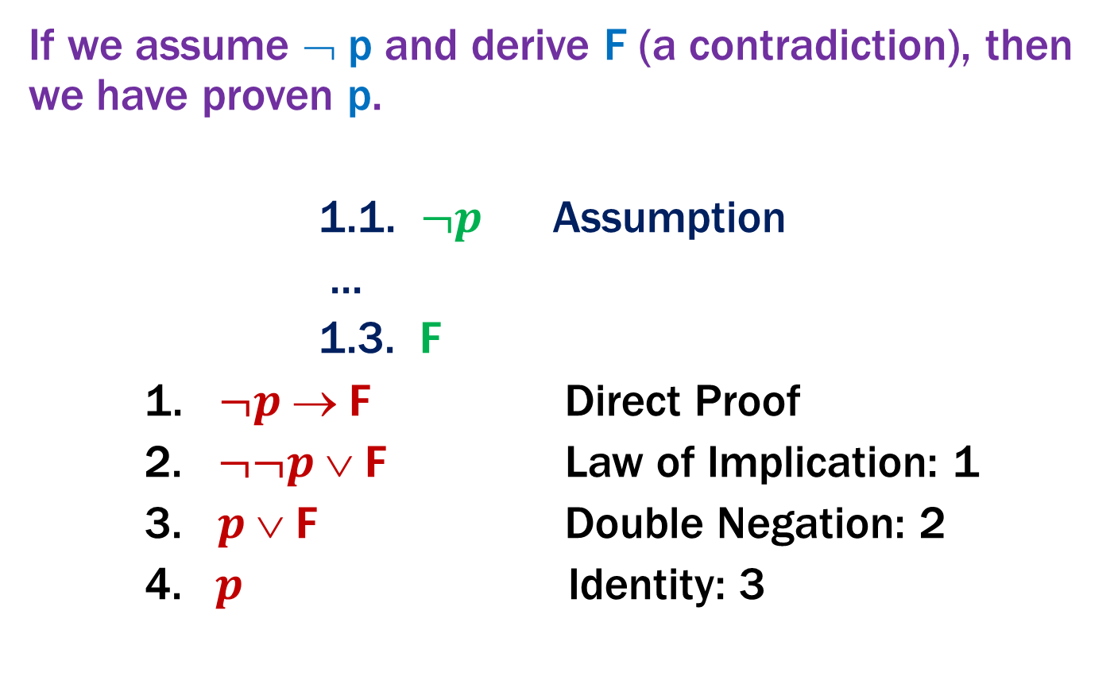
Proof by Contradiction: One way to prove p
If we assume ¬ p and derive F (a contradiction), then we have proven p.
1.1. $¬p$ Assumption
...
1.3. $F$
1. $¬p  F$ Direct Proof
2. $¬¬p  F$ Law of Implication: 1
3. $p  F$ Double Negation: 2
4. $p$ Identity: 3
Notes:
English proof would start: “We will prove this by contradiction. ... F, which is a contradiction.”

Slide 19

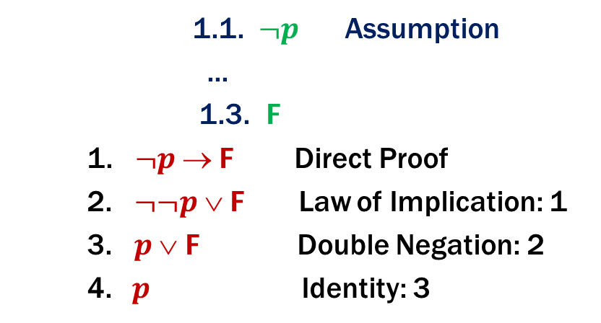
Proof Strategies: Proof by Contradiction
If we assume ¬ p and derive F (a contradiction), then we have proven p.
We will argue by contradiction.
Suppose $¬p.$
...
This is a contradiction.
1.1. $¬p$ Assumption
...
1.3. $F$
1. $¬p  F$ Direct Proof
2. $¬¬p  F$ Law of Implication: 1
3. $p  F$ Double Negation: 2
4. $p$ Identity: 3
Often, we will infer ¬R, where R is a prior fact. Putting these together, we have R ∧ ¬R ≡ F
Notes:
Nothing at the end.

Slide 20
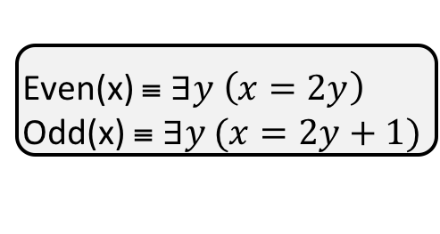
Even and Odd
Predicate Definitions
Even(x) ≡ $∃y \left(x=2y\right)$
Odd(x) ≡ $∃y (x=2y+1)$
Domain of Discourse
Rationals
Prove: “No integer is both even and odd.”
Formally, prove ¬ ∃x (Even(x)∧Odd(x))
Proof: We will argue by contradiction.

Slide 21
Even and Odd
Predicate Definitions
Even(x) ≡ $∃y \left(x=2y\right)$
Odd(x) ≡ $∃y (x=2y+1)$
Domain of Discourse
Rationals
Prove: “No integer is both even and odd.”
Formally, prove ¬ ∃x (Even(x)∧Odd(x))
Proof: We will argue by contradiction.
Suppose that x is an integer that is both even and odd.
This is a contradiction.

Slide 22
Even and Odd
Predicate Definitions
Even(x) ≡ $∃y \left(x=2y\right)$
Odd(x) ≡ $∃y (x=2y+1)$
Domain of Discourse
Rationals
Prove: “No integer is both even and odd.”
Formally, prove ¬ ∃x (Even(x)∧Odd(x))
Proof: We will argue by contradiction.
Suppose that x is an integer that is both even and odd. Then, x=2a for some integer a, and x=2b+1 for some integer b.
This is a contradiction.

Slide 23
Even and Odd
Predicate Definitions
Even(x) ≡ $∃y \left(x=2y\right)$
Odd(x) ≡ $∃y (x=2y+1)$
Domain of Discourse
Rationals
Prove: “No integer is both even and odd.”
Formally, prove ¬ ∃x (Even(x)∧Odd(x))
Proof: We will argue by contradiction.
Suppose that x is an integer that is both even and odd. Then, x=2a for some integer a, and x=2b+1 for some integer b. This means 2a=x=2b+1 and hence 2a-2b=1 and so a-b=½. But a-b is an integer while ½ is not, so they cannot be equal. This is a contradiction.
Formally, we’ve shown Integer(½) ∧ ¬Integer(½) ≡ F.

Slide 24
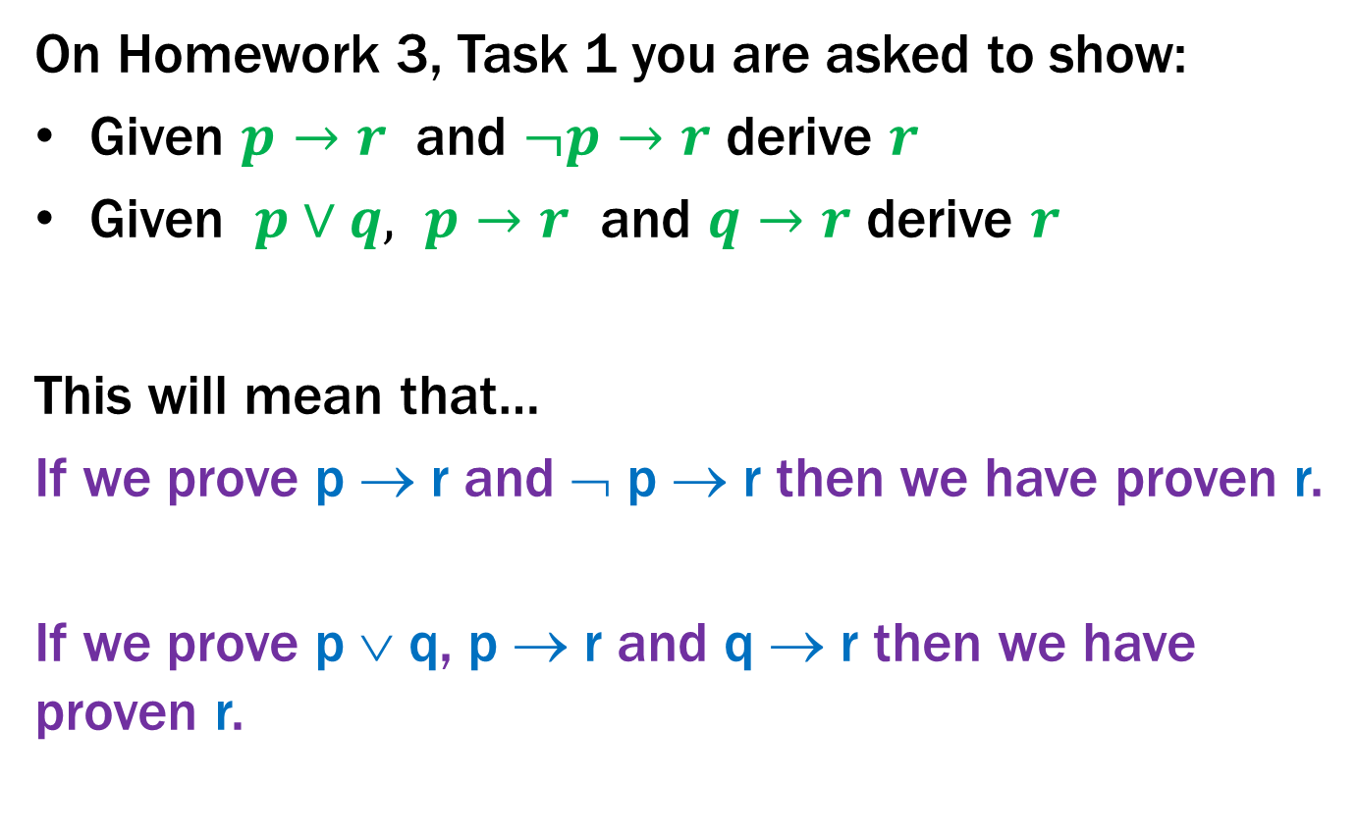
Proof by Cases
On Homework 3, Task 1 you are asked to show:
Given $p→r$ and $¬p→r$ derive $r$
Given $p∨q, p→r$ and $q→r$ derive $r$
This will mean that…
If we prove p → r and ¬ p → r then we have proven r.
If we prove p ∨ q, p → r and q → r then we have proven r.

Slide 25
Strategies
Simple proof strategies already do a lot
counter examples
proof by contrapositive
proof by contradiction
proof by cases
Later we will cover a specific strategy that applies to loops and recursion (mathematical induction)

Slide 26
Applications of Predicate Logic
Remainder of the course will use predicate logic to prove important properties of interesting objects
start with math objects that are widely used in CS
eventually more CS-specific objects
Encode domain knowledge in predicate definitions
Then apply predicate logic to infer useful results
Domain of Discourse
Predicate Definitions
Integers
Even(x) ≡ ∃y (x = 2⋅y)
Odd(x) ≡ ∃y (x = 2⋅y + 1)

Slide 27
Number Theory

Slide 28
Number Theory (and applications to computing)
Branch of Mathematics with direct relevance to computing
Many significant applications
Cryptography & Security
Data Structures
Distributed Systems
Important toolkit

Slide 29
Modular Arithmetic
Arithmetic over a finite domain
Almost all computation is over a finite domain

Slide 30
I’m ALIVE!
public class Test {
final static int SEC_IN_YEAR = 364*24*60*60*100;
public static void main(String args[]) {
System.out.println(
“I will be alive for at least ” +
SEC_IN_YEAR * 101 + “ seconds.”
);
}
}
[-128, 127]
14
-116

Slide 31
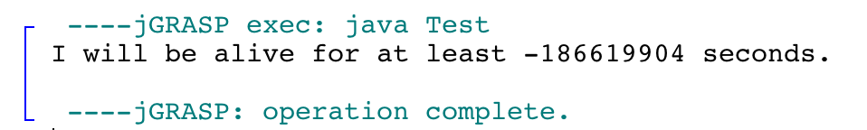
I’m ALIVE!
public class Test {
final static int SEC_IN_YEAR = 364*24*60*60*100;
public static void main(String args[]) {
System.out.println(
“I will be alive for at least ” +
SEC_IN_YEAR * 101 + “ seconds.”
);
}
}
[-128, 127]
Prints : “I will be alive for at least -186619904 seconds.”
14
-116

Slide 32
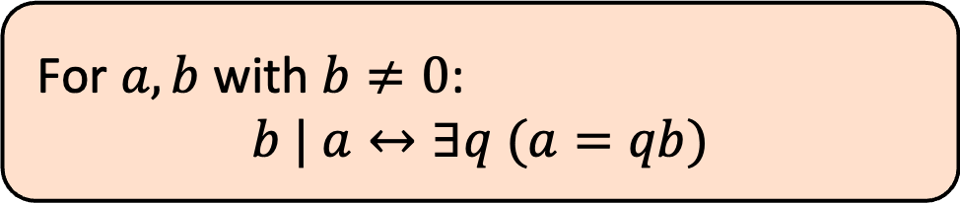
Divisibility
Domain of Discourse
Integers
Definition: “b divides a”
For $a,b$ with $b≠0$:
$$b | a↔∃q (a=qb)$$
Check Your Understanding. Which of the following are true?
5 | 1 25 | 5 5 | 0 3 | 2
1 | 5 5 | 25 0 | 5 2 | 3

Slide 33
Divisibility
Domain of Discourse
Integers
Definition: “b divides a”
For $a,b$ with $b≠0$:
$$b | a↔∃q (a=qb)$$
Check Your Understanding. Which of the following are true?
5 | 1 25 | 5 5 | 0 3 | 2
1 | 5 5 | 25 0 | 5 2 | 3
5 | 1 iff 1 = 5k
25 | 5 iff 5 = 25k
5 | 0 iff 0 = 5k
3 | 2 iff 2 = 3k
1 | 5 iff 5 = 1k
5 | 25 iff 25 = 5k
0 | 5 iff 5 = 0k
2 | 3 iff 3 = 2k

Slide 34
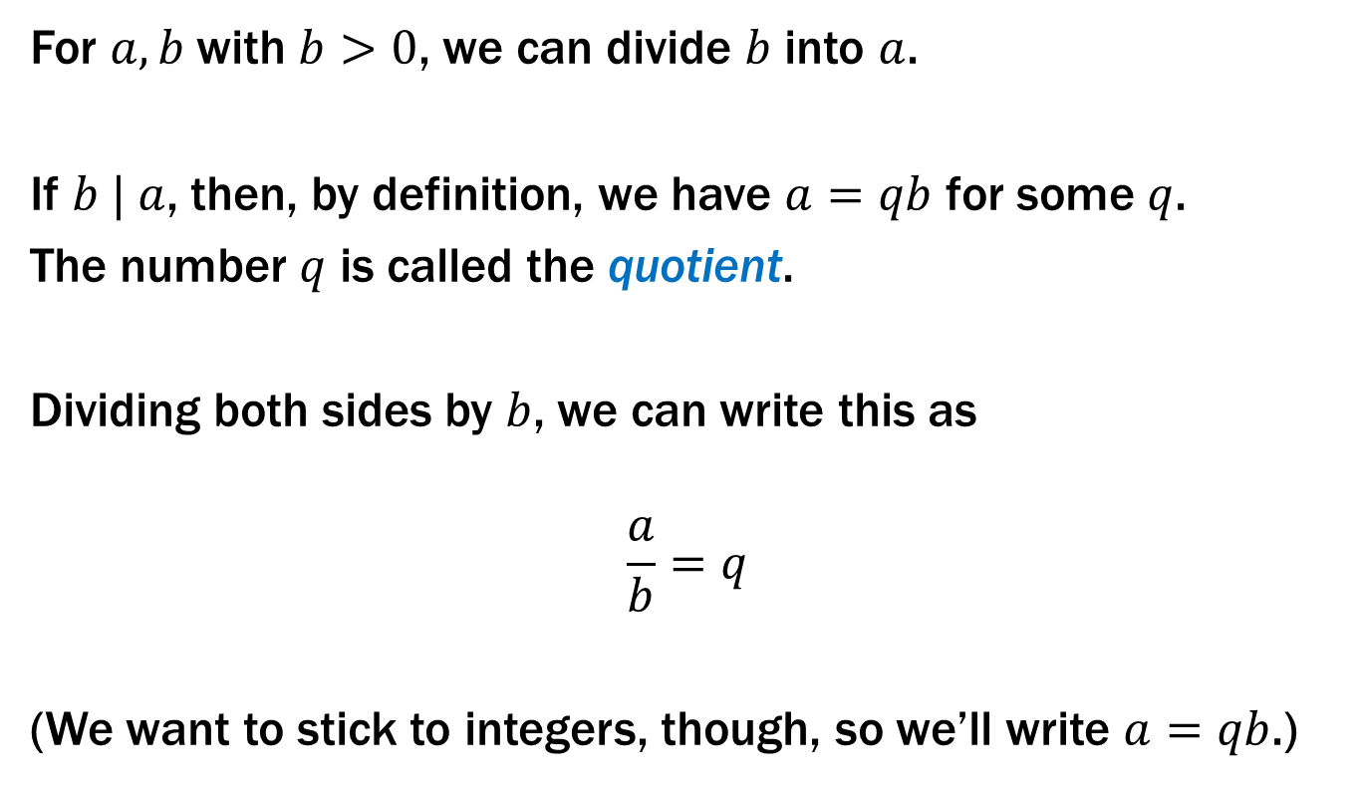
Recall: Elementary School Division
For $a,b$with $b>0$, we can divide $b$ into $a$.
If $b | a$, then, by definition, we have $a=qb$ for some $q$.
The number $q$ is called the quotient.
Dividing both sides by $b$, we can write this as
$$\frac{a}{b}=q$$
(We want to stick to integers, though, so we’ll write $a=qb$.)

Slide 35
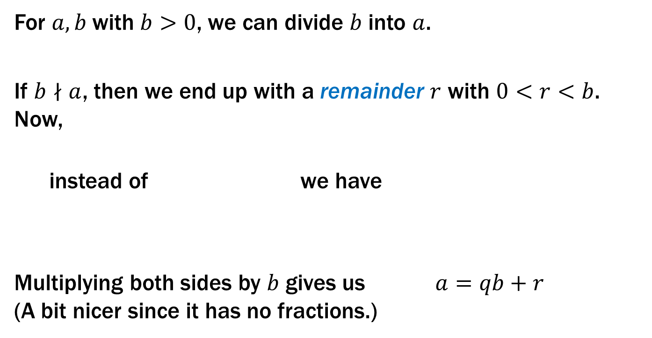
Recall: Elementary School Division
For $a,b$with $b>0$, we can divide $b$ into $a$.
If $b∤a$, then we end up with a remainder $r$ with $0<r<b$. Now,
instead of we have
Multiplying both sides by $b$ gives us $a=qb+r$ (A bit nicer since it has no fractions.)
$$\frac{a}{b}=q$$
$$\frac{a}{b}=q+\frac{r}{b}$$

Slide 36
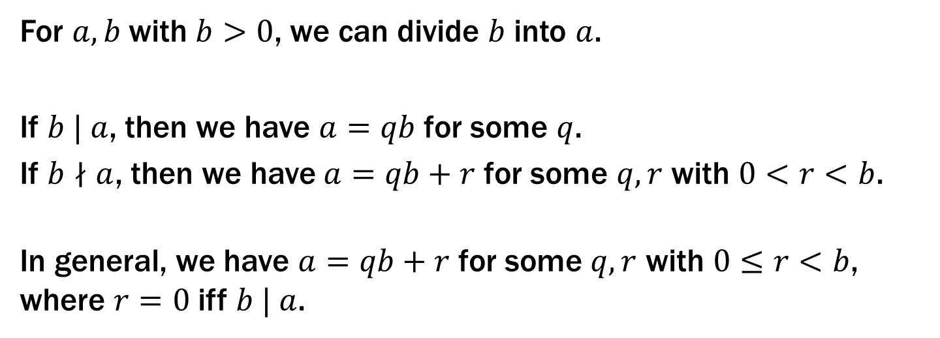
Recall: Elementary School Division
For $a,b$with $b>0$, we can divide $b$ into $a$.
If $b | a$, then we have $a=qb$ for some $q$.
If $b∤a$, then we have $a=qb+r$ for some $q,r$ with $0<r<b$.
In general, we have $a=qb+r$ for some $q,r$ with $0≤r<b$, where $r=0$ iff $b | a$.

Slide 37
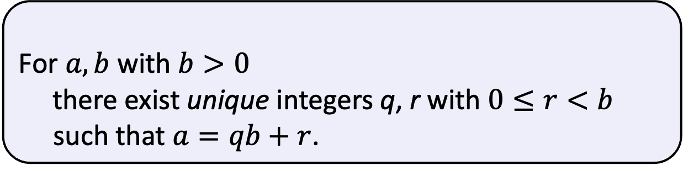
Division Theorem
Domain of Discourse
Integers
Division Theorem
For $a,b$ with $b>0$
there exist unique integers q, r with $0≤r<b$ such that $a=qb+r$.
To put it another way, if we divide b into a, we get a unique quotient and non-negative remainder
q = a div b
r = a mod b
Note: r ≥ 0 even if a < 0.
Not quite the same as a % b.

Slide 38
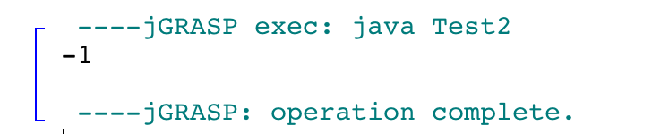
Division Theorem
Domain of Discourse
Integers
Division Theorem
For $a,b$ with $b>0$
there exist unique integers q, r with $0≤r<b$ such that $a=qb+r$.
To put it another way, if we divide b into a, we get a unique quotient and non-negative remainder
q = a div b
r = a mod b
public class Test2 {
public static void main(String args[]) {
int a = -5;
int b = 2;
System.out.println(a % b);
}
}
Note: r ≥ 0 even if a < 0.
Not quite the same as a % b.

Slide 39
div and mod
x = 7 · (x div 7) + (x mod 7)
0 1 2 3 4 5 6 0 1 2 3 4 5 6 0 1 2 3 4 5 6 0 1
x mod 7
-1 -1 -1 -1 -1 -1 -1 0 0 0 0 0 0 0 1 1 1 1 1 1 1 2 2
x div 7
-7 -6 -5 -4 -3 -2 -1 0 1 2 3 4 5 6 7 8 9 10 11 12 13 14 15
7 · (-1)
7 · 0
x
7 · 1
7 · 2

